Slide 1

SSBM Video Search Engine
Connor Bradford

Slide 2

Overview

Slide 3
Requirements
Must correctly apply the filters to the set of videos and supply correct information
UI must be user friendly and not too congested on the page
Must search for videos relatively quickly

Slide 4



Tools

Slide 5
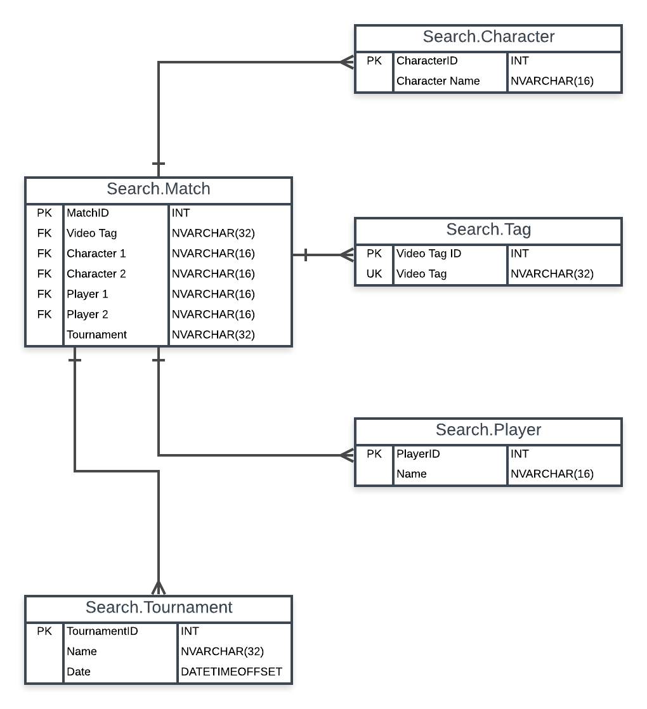
Initial Database Design

Slide 6

Creating the Project

Slide 7
Creating the Web Application
Filters
Search
Video cards

Slide 8

YouTube API
Title
ID
URL
Duration
Thumbnail

Slide 9

Demo

Slide 10
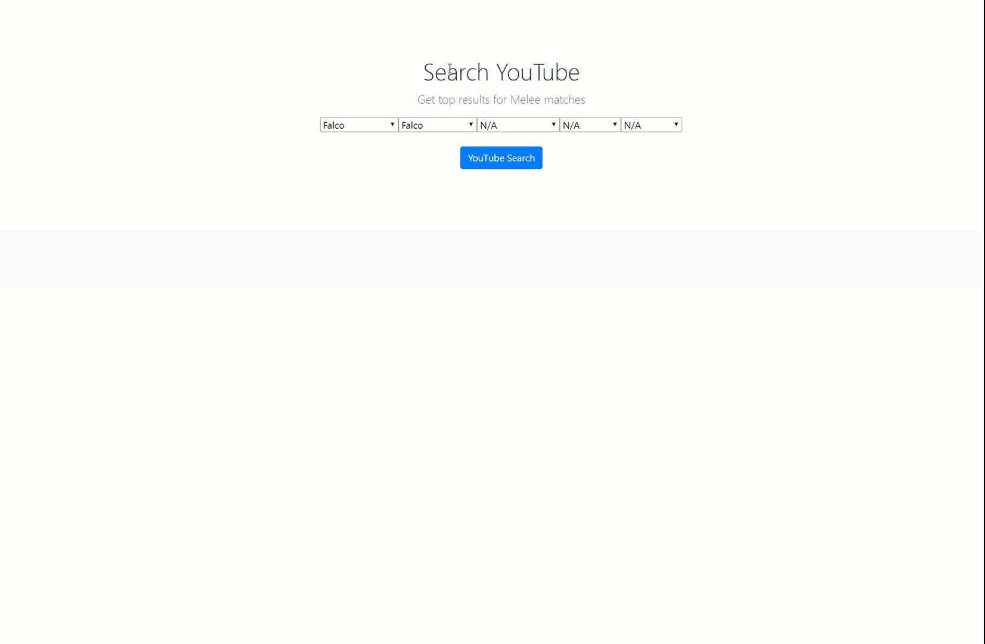

Slide 11

Testing

Slide 12
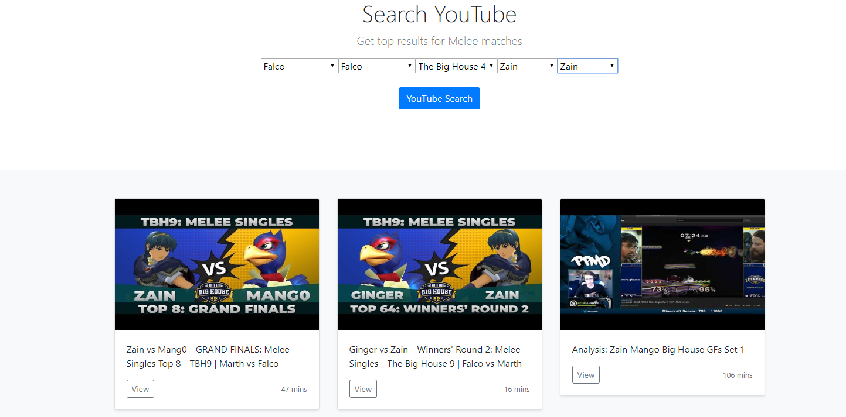

Slide 13
Future Work
Database
Video description in video card
Allow user to specify number of videos
Allow user to get X additional videos

Slide 14

Questions?

